Slide 1

Predicting the likelihood of a company’s bankruptcy
Hasan Khan

Slide 2






Data flow architecture diagram
S3 buckets to form a Data Lake
Redshift- query and perform data cleaning (data warehouse)
Sagemaker- Machine Learning
Data- CSV and TXT
Create classification model to predict likelihood of bankruptcy for a company
Glue- ETL Processes

Slide 3
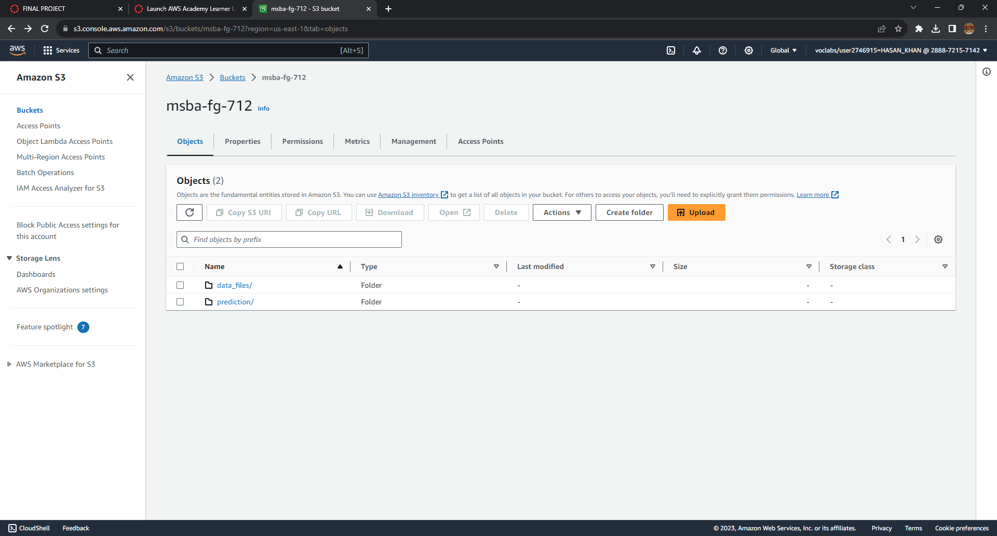
Storing the Data to build foundation of data lake

Slide 4
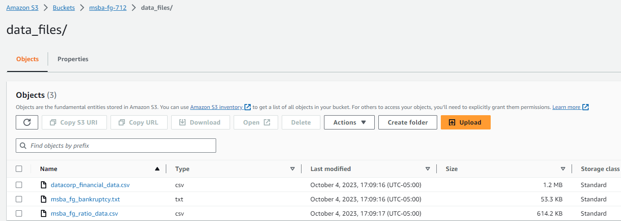
Data used in the model

Slide 5
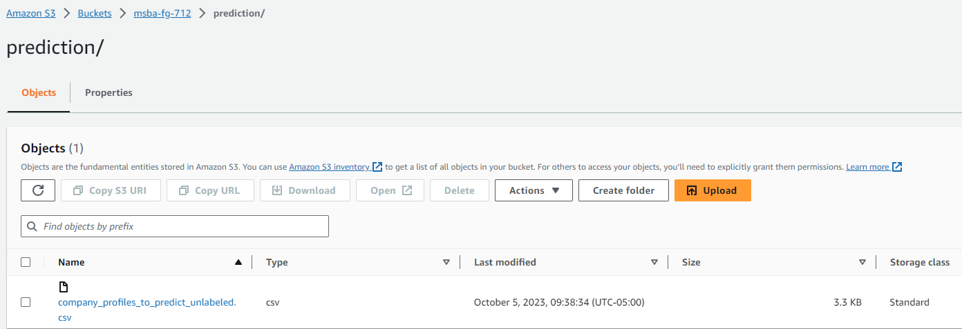
Companies we will use the model to predict bankruptcy likelihood

Slide 6
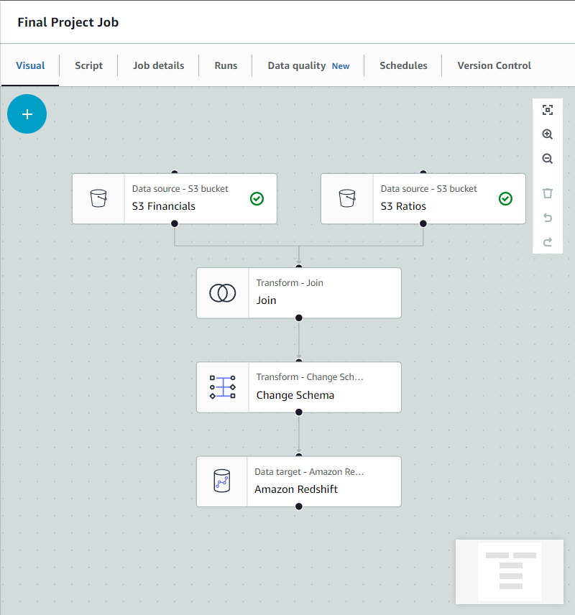
GLUE JOB

Slide 7
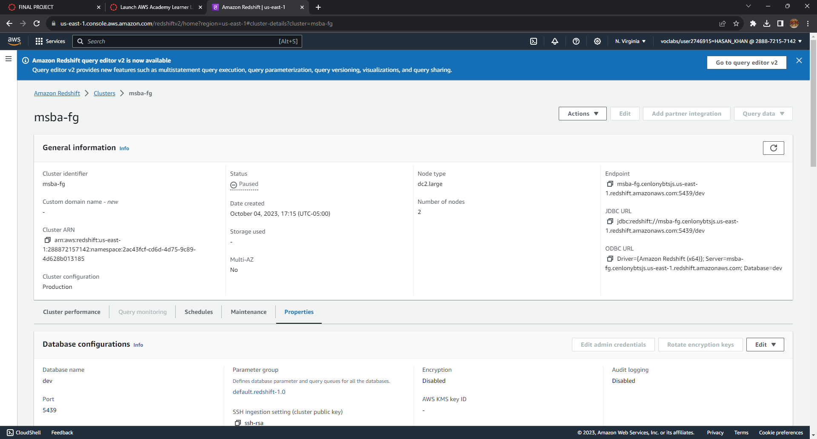
REDSHIFT CLUSTER- data warehouse

Slide 8
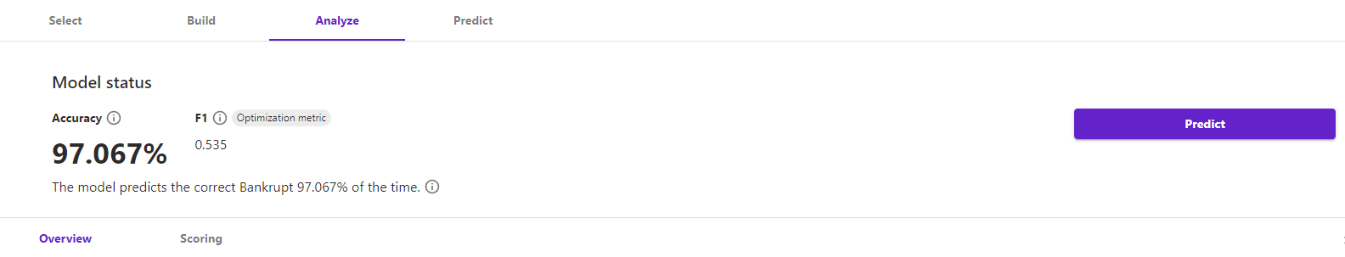
Sagemaker model results

Slide 9
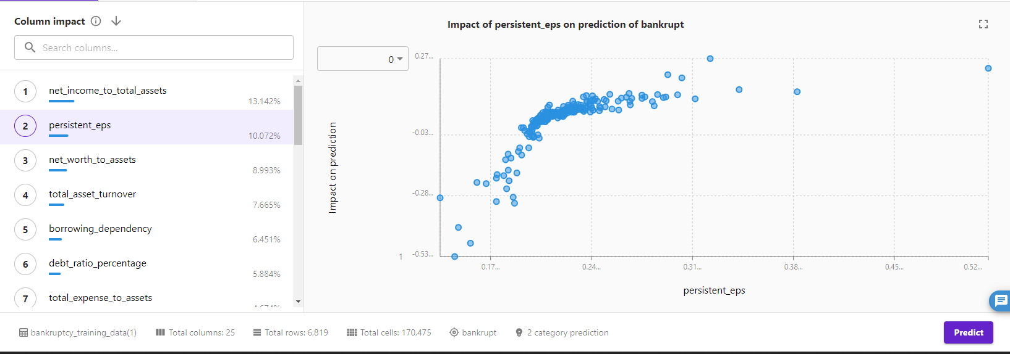
Persistent Earnings per share (EPS)

Slide 10
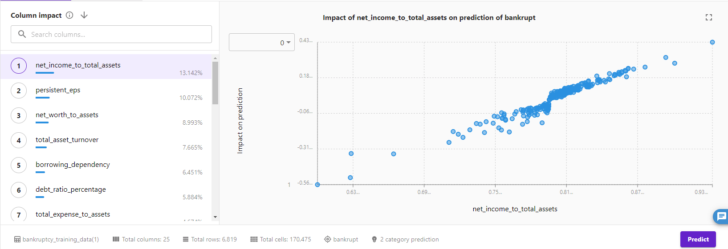
Net income to assets

Slide 11
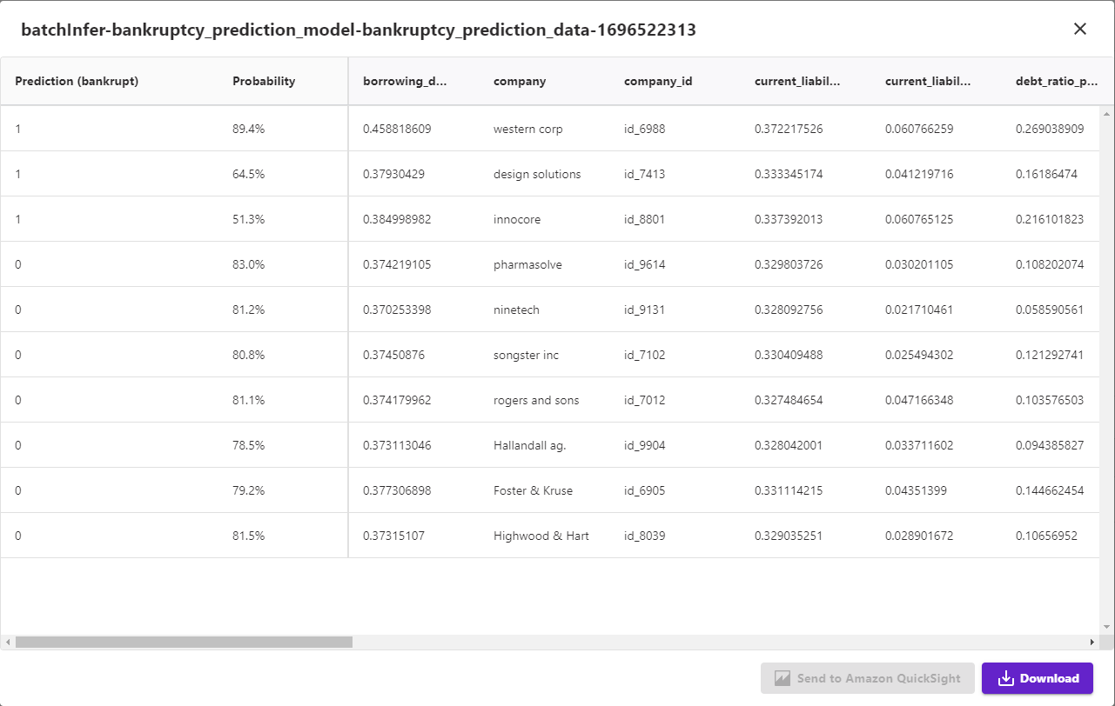
Model predictions

Slide 12
Thank you!

